Slide 1
CSE323 Memory Management
These slides were compiled from the OSC textbook slides (Silberschatz, Galvin, and Gagne) and the instructor’s class materials.
CSE323 Memory Management
Notes:
Hello! Everyone,
My name is Shinya Kobayashi. Today, I am going to present our paper titled “Inter-Cluster Job Coordination Using Mobile Agents” on behalf of the first author, Munehiro Fukuda. Munehiro was hoping to show up and present the paper at AMS2001, however he got to wait in Japan until he will get an H1B visa. Since I received the presentation materials from him quite recently, please allow me to present this paper using this script.
I can respond to your questions as far as I know, however you can also ask Munehiro by email. His email address is on the title page of our paper.
(time 1:05)

Slide 2

Base and Limit Registers
A pair of base and limit registers define the logical address space
CPU must check every memory access generated in user mode to be sure it is between base and limit for that user

Slide 3

Hardware Address Protection with Base and Limit Registers

Slide 4
Address Binding
Programs on disk, ready to be brought into memory to execute form an input queue
Inconvenient to have first user process physical address always at 0000
Addresses represented in different ways at different stages of a program’s life
  Source code addresses are usually symbolic
  A Compiler bind this symbolic address to relocatable addresses
    i.e. “14 bytes from beginning of this module”
  Linker or loader will bind relocatable addresses to absolute addresses
    i.e. 74014
  Each binding maps one address space to another

Slide 5
From Source to Executable
Machine
memory
source
program
foo.c
object
modules
foo.o
other
programs
...
main
sub1
data
printf
exit
data
other
...
...
kernel
main()
sub1()
data
main
sub1
data
load
module
a.out
?
Compiler
main
sub1
data
printf
exit
data
(system
calls)
static
library
libc.a
(Run Time)
Loader
printf
scanf
gets
fopen
exit
data
...
Linkage
Editor
“Load time”
Dynamic library case not shown
CSE323 Memory Management

Slide 6
Binding of Instructions and Data to Memory Addresses
Compile time: If memory location known a priori, absolute code can be generated; must recompile code if starting location changes.
Load time: If memory location is not known at compile time, compiler must generate relocatable code.
  Loader knows final location and binds addresses for that location
Execution time: If the process can be moved during its execution, binding must be delayed until run time. Need hardware support for address maps (e.g., base and limit registers).
CSE323 Memory Management

Slide 7
Memory-Management Unit (MMU)
MMU is the Hardware device that maps virtual address to physical address at run time
To start, consider simple scheme where the value in the relocation register is added to every address generated by a user process at the time it is sent to memory
  Base register now called relocation register
  MS-DOS on Intel 80x86 used 4 relocation registers
The user program deals with logical addresses; it never sees the real physical addresses
  Execution-time binding occurs when reference is made to location in memory

Slide 8
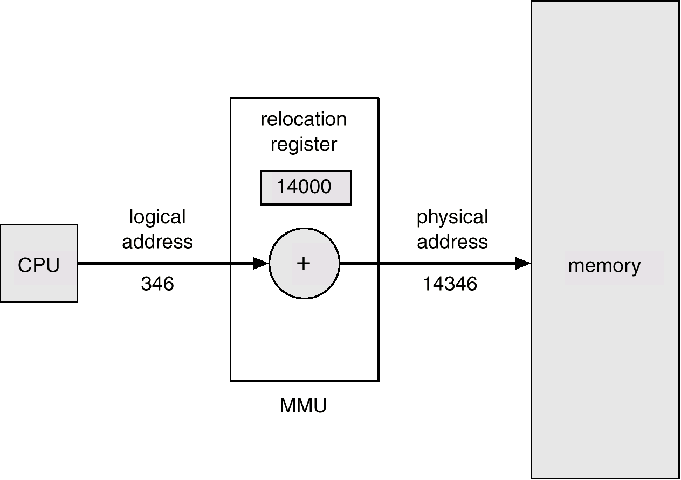
Logical vs. Physical Address Space
Dynamic relocation using a relocation register
Physical address: The actual hardware memory address.
  32-bit CPU’s physical address 0 ~ 2³²-1 (00000000 – FFFFFFFF)
  128MB’s memory address 0 ~ 2²⁷-1
  (00000000 – 07FFFFFF)
Logical address: Each (relocatable) program assumes the starting location is always 0 and the memory space is much larger than actual memory
CSE323 Memory Management

Slide 9
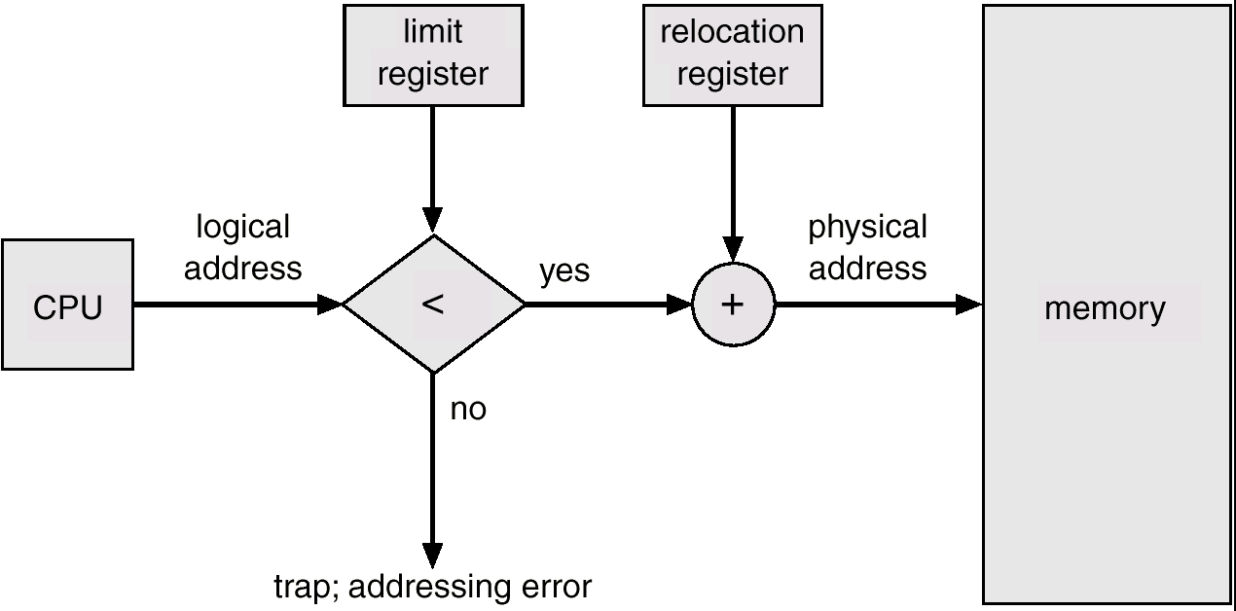
Memory Protection
For each process
  Logical space is mapped to a contiguous portion of physical space
  A relocation and a limit register are prepared
    Relocation register = the value of the smallest physical address
    Limit register = the range of logical address space
CSE323 Memory Management

Slide 10
Memory Protection
When the CPU scheduler selects a process for execution, the dispatcher loads the relocation and limit registers with the correct values as part of the context switch.
Every address generated by the CPU is checked against these registers.
CSE323 Memory Management

Slide 11
Dynamic Loading
Unused routine is never loaded
Useful when the code size is large
Unix execv can be categorized:
  Overloading a necessary program onto the current program.
main( ) {
f1( );
}
f1( ) {
f2( );
}
f2( ) {
f3( );
}
1. Loaded when called
memory
2. Loaded when called
3. Loaded when called
CSE323 Memory Management

Slide 12
Dynamic Linking
Linking postponed until execution time.
Small piece of code, stub, used to locate the appropriate memory-resident library routine.
Stub replaces itself with the address of the routine, and executes the routine.
Operating system needs to check if routine is in processes’ memory address
int x;
void main(){
stub = dlopen(“lib”):
f = dlsym(stub, “f1”);
f( );
}
memory
int x;
void main(){
stub = dlopen(“lib”):
f = dlsym(stub, “f1”);
f( );
}
lib.so.a
extern int x;
f1( ) {
x = 5;
}
extern int x;
f1( ) {
x = 5;
}
CSE323 Memory Management

Slide 13
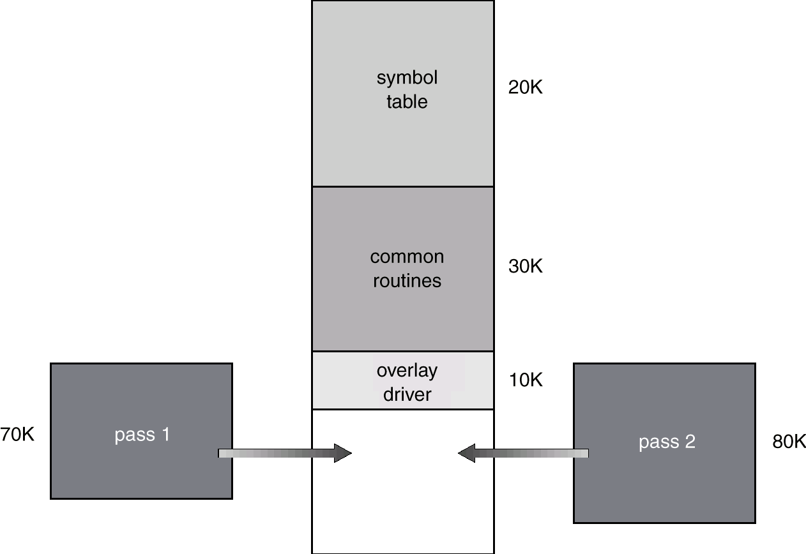
Overlays
Code and data used at any given time are placed in memory.
New code is overloaded onto the code not used any more.
It is not so frequently used now.
CSE323 Memory Management

Slide 14

Swapping
When a process p1 is blocked so long (for I/O), it is swapped out to the backing store, (swap area in Unix.)
When a process p2 is (served by I/O and ) back to a ready queue, it is swapped in the memory.
Use the Unix top command to see which processes are swapped out.
CSE323 Memory Management

Slide 15
Contiguous Memory Allocation
The main memory is usually divided into two parts : one for the operating system and one for the user processes.
Where the OS will reside will decide upon the location of interrupt vector.
CSE323 Memory Management

Slide 16
Memory Allocation
(Fixed sized partition)
OS
Memory is divided to fixed-sized partitions
Each partition is allocated to a process
IBM OS/360
Then, how about this process?
process1
process2
process4
?
process3
CSE323 Memory Management

Slide 17
Variable-Sized Partitions
Primarily used in Batch environment
The OS keeps a table indicating which parts of memory are available and which are occupied
Initially all memory is available for the user processes and is considered as one large block of available memory, “HOLE”.
When a process arrives and needs memory, we search for a hole large enough for this process.
If we find one, we allocate only as much memory as is needed.
CSE323 Memory Management

Slide 18
Variable-Sized Partitions
Whenever one of running processes, (p8) is terminated
  Find a ready process whose size is best fit to the hole, (p9)
  Allocate it from the top of hole
If there is still an available hole, repeat the above (for p10).
Any size of processes, (up to the physical memory size) can be allocated.
OS
OS
OS
OS
process 5
process 5
process 5
process 5
process 9
process 9
process 8
process 10
process 2
process 2
process 2
process 2
CSE323 Memory Management

Slide 19
Dynamic Storage-Allocation Problem
First-fit: Allocate the first hole that is big enough. (Fastest search)
Best-fit: Allocate the smallest hole that is big enough; must search entire list, unless ordered by size. Produces the smallest leftover hole. (Best memory usage)
Worst-fit: Allocate the largest hole; must also search entire list. Produces the largest leftover hole (that could be used effectively later.)
http://thumbsup2life.blogspot.com/2011/02/best-fit-first-fit-and-worst-fit-memory.html
First-fit and best-fit better than worst-fit in terms of speed and storage utilization.
CSE323 Memory Management

Slide 20
Example
Memory Block Size
Block 1 50k
Block 2 200k
Block 3 70k
Block 4 115k
Block 5 15k
List of Jobs | Size | Turnaround
Job 1 | 100k | 3
Job 2 | 10k | 1
Job 3 | 35k | 2
Job 4 | 15k | 1
Job 5 | 23k | 2
Job 6 | 6k | 1
Job 7 | 25k | 1
Job 8 | 55k | 2
Job 9 | 88k | 3
Job 10 | 100k | 3
CSE323 Memory Management

Slide 21
Best Fit (Turn 1 and 2)
Block | Size | Process
1 | 50 | P3
2 | 200 | P5
3 | 70 | P4
4 | 115 | P1
5 | 15 | P2
Block | Size | Process
1 | 50 | P3
2 | 200 | P5
3 | 70 | P7
4 | 115 | P1
5 | 15 | P6
CSE323 Memory Management

Slide 22
Best Fit (Turn 3 and 4)
Block | Size | Process
1 | 50
2 | 200 | P9
3 | 70 | P8
4 | 115 | P1
5 | 15
Block | Size | Process
1 | 50
2 | 200 | P9
3 | 70 | P8
4 | 115 | P10
5 | 15
CSE323 Memory Management

Slide 23
Best Fit (Turn 5 and 6)
Block | Size | Process
1 | 50
2 | 200 | P9
3 | 70
4 | 115 | P10
5 | 15
Block | Size | Process
1 | 50
2 | 200
3 | 70
4 | 115 | P10
5 | 15
CSE323 Memory Management

Slide 24
External Fragmentation
Problem
  50-percent rule (for first fit): total memory space exists to satisfy a request, but it is not contiguous.
Solution
  Compaction: shuffle the memory contents to place all free memory together in one large block
    Relocatable code
    Expensive
  Paging: Allow non-contiguous logical-to-phyiscal space mapping.
process1
process3
Can’t fit
Shift up
process2
CSE323 Memory Management

Slide 25
Internal Fragmentation
With the scheme of breaking the physical memory into fixed-sized blocks, and allocate memory in unit of block size, results internal fragmentation.
With this approach, the memory allocated to a process may be slightly larger than the requested memory. The difference between these two number is internal fragmentation.
CSE323 Memory Management

Slide 26
Segmentation
Memory-management scheme that supports user view of memory
A program is a collection of segments
  A segment is a logical unit such as:
main program
procedure
function
method
object
local variables, global variables
common block
stack
symbol table
arrays

Slide 27

User’s View of a Program

Slide 28
Logical View of Segmentation
Data
Data
Heap
Stack
Code
Heap
Stack
Code
user view of memory
logical memory space

Slide 29
Segmentation Architecture
Logical address consists of a two tuple:
<segment-number, offset>,
Segment table – maps two-dimensional physical addresses; each table entry has:
  base – contains the starting physical address where the segments reside in memory
  limit – specifies the length of the segment
Segment-table base register (STBR) points to the segment table’s location in memory
Segment-table length register (STLR) indicates number of segments used by a program;
segment number s is legal if s < STLR

Slide 30
Segmentation Architecture (Cont.)
Protection
  With each entry in segment table associate:
    validation bit = 0 ⇒ illegal segment
    read/write/execute privileges
Protection bits associated with segments; code sharing occurs at segment level
Since segments vary in length, memory allocation is a dynamic storage-allocation problem
A segmentation example is shown in the following diagram

Slide 31

Segmentation Hardware

Slide 32
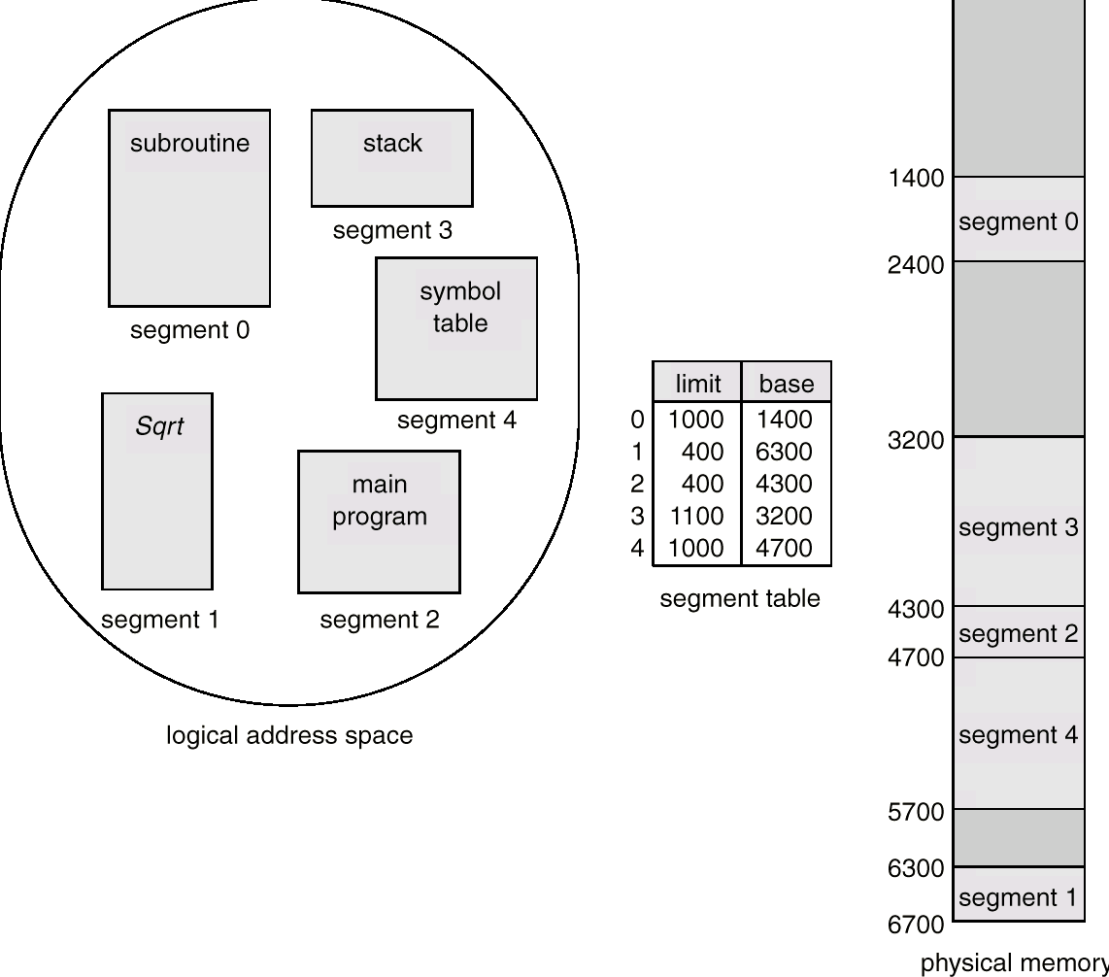
Segmentation Example
offset d2
offset d1
SP
d1
used
Currently executed
PC
d2
Stack top
used
CSE323 Memory Management

Slide 33
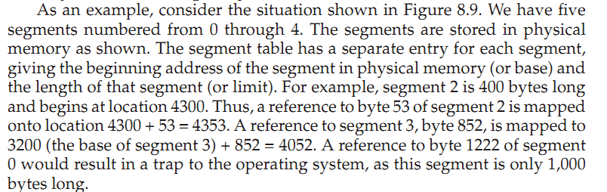
CSE323 Memory Management

